Slide 1

Trustworthy Autonomous Systems
Enhancing Fairness and its Impact on Explainability

Slide 2
Project Overview
Objective: Investigating Fairness – Explainability Trade-offs in ML Models
Team: Alexandra Biddiscombe, Youssef Sedra, William Ambrosetti

Slide 3
Dataset Description
German Credit Dataset
20 Attributes
1000 Samples
6 Protected Features (initially selected) → 1 Protected Feature in unbiasing

Slide 4
Data Pre Processing
One-hot encoding of categorical features
Scale numerical features for better model performance
No missing or duplicate data
Normalization of numerical features:
  ‘Duration in month’
  ‘Credit amount’
  ‘Age in years’

Slide 5
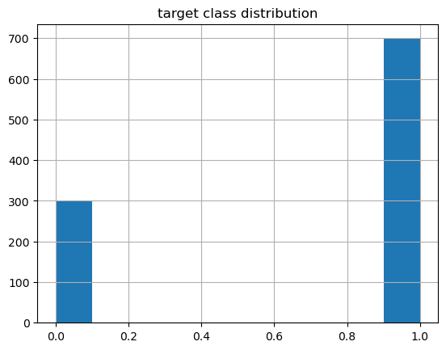
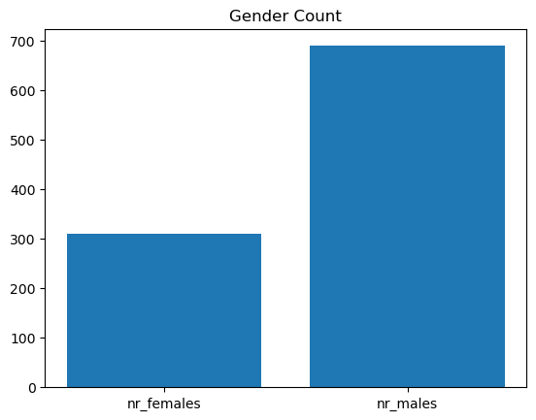
Exploratory Data Analysis
Bad decision
Good decision

Slide 6
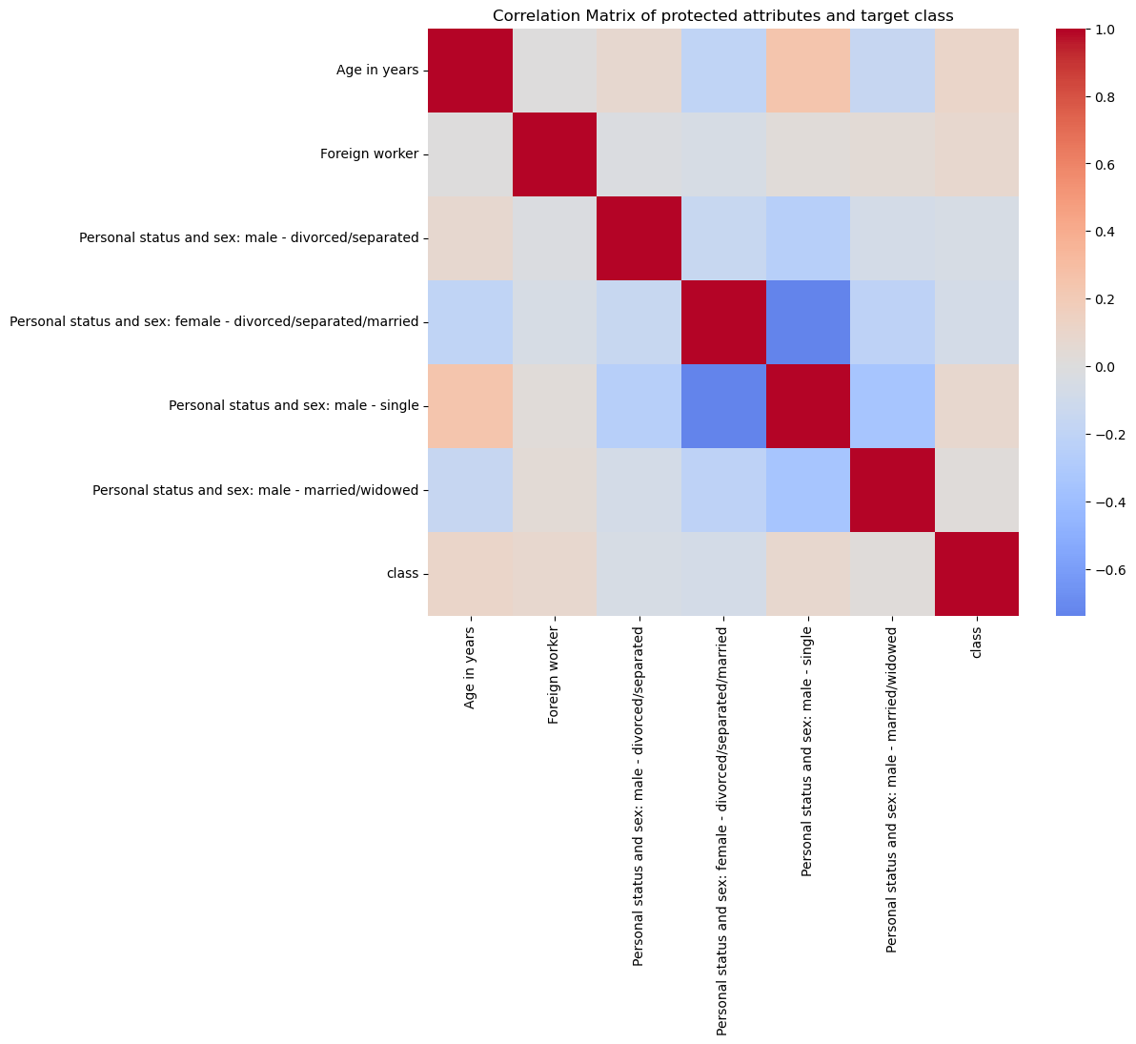
Exploratory Data Analysis
Protected feature correlation with each other and target class

Slide 7
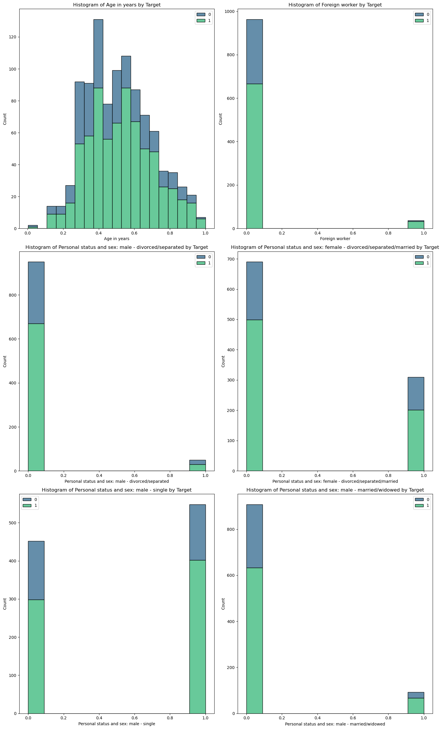
Exploratory Data Analysis
Age in years
Foreign worker
Protected feature distribution in regards of target class
Male – divorced/separated
Female – divorced/separated
Single - male
Female – widowed/married

Slide 8
Initial Models development and prioritization
Optimize parameters using Grid Search CV (5)
Model 1
  Random forest classifier
  - min leaf sample: 2
  - min sample split: 5
  - n_estimators: 155
Model 2
  XGB classifier
  - learning rate: 0.1
  - max_depth: 4
  - n_estimators: 95
Model 3
  MLP classifier
  - activation: tanh
  - alpha: 0.1
  - hidden layer size: (100, )

Slide 9
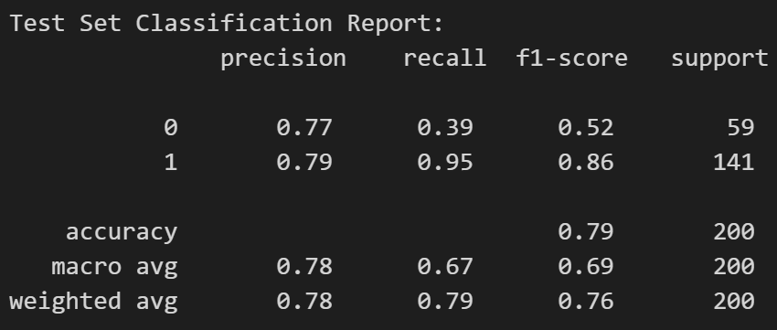
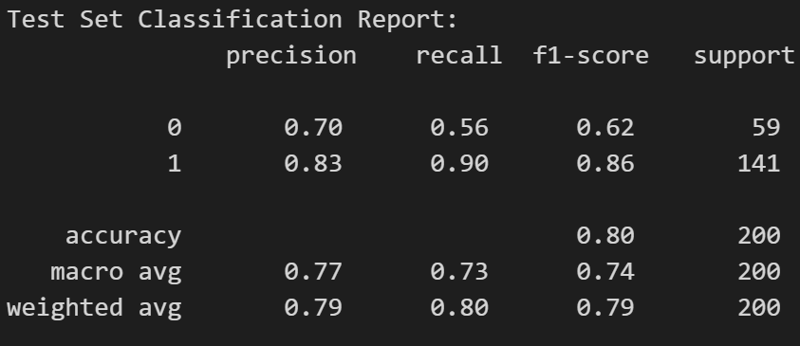
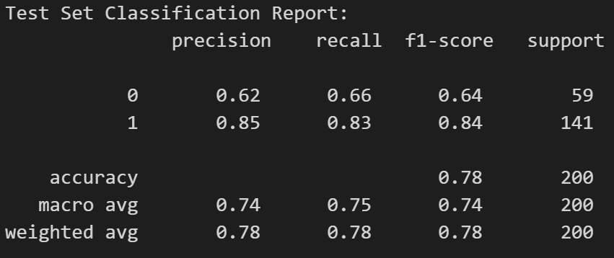
Model performance metrics
Random Forest Classifier
XGB Classifier
MLP Classifier

Slide 10
Local shap

Slide 11
Global shap

Slide 12
Fairness assessment

Slide 13
Fairness mitigation techniques

Slide 14
Fair model shap analysis

Slide 15
Fair model local shap

Slide 16
Unfair vs fair model performance

Slide 17
Explanation differences

Slide 18
conclusion

Slide 19
Thank you q&a

